Slide 1
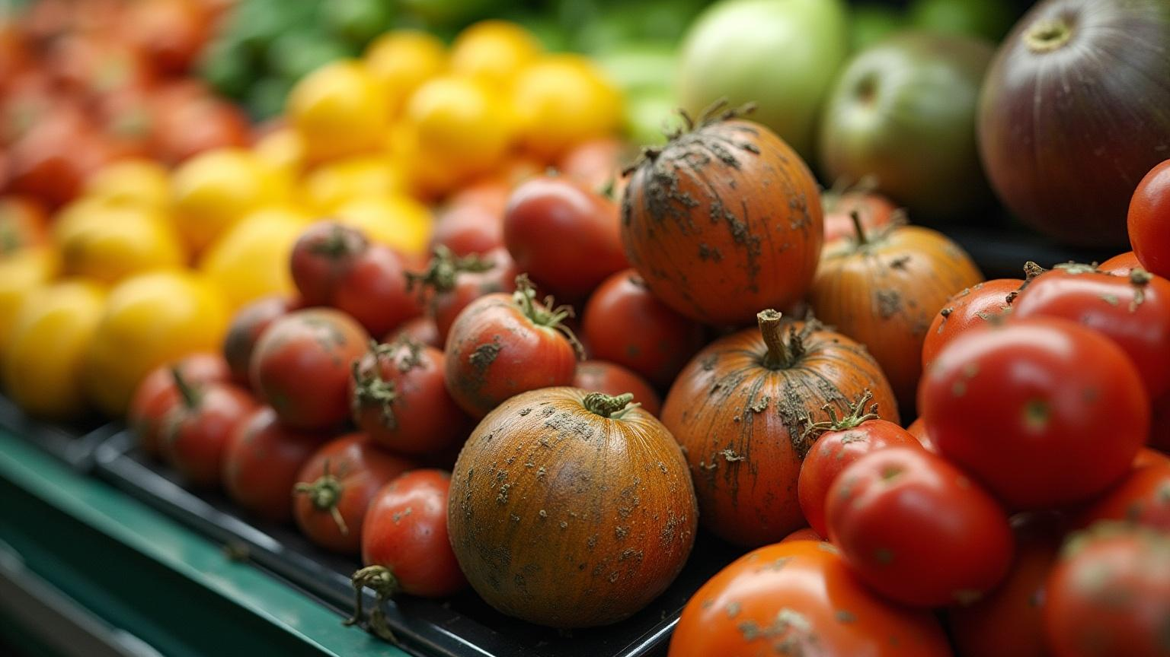
Smart Sorting
Leveraging Transfer Learning to Identify Rotten Fruits and Vegetables

Slide 2

Introduction
This presentation explores the application of transfer learning in the detection of rotten fruits and vegetables. It highlights key concepts, significance in machine learning, and innovative methods for identifying and sorting spoiled produce to enhance food quality and reduce waste.

Slide 3

Transfer Learning Overview
01

Slide 4
Definition and Key Concepts
Transfer learning involves transferring knowledge from one domain to another, significantly enhancing the model's efficiency and accuracy in new but related tasks. It is particularly advantageous in scenarios with limited labeled data, making it a powerful tool in machine learning.

Slide 5
Importance in Machine Learning
Transfer learning accelerates the training process, reduces the need for extensive datasets, and improves the performance of models in specialized tasks. In the agricultural sector, it aids in developing robust models for detecting rotten produce, ultimately leading to better food safety and quality control.

Slide 6

Applications in Agriculture
Transfer learning is increasingly applied in agriculture for various tasks, including pest detection, yield prediction, and, significantly, the identification of spoiled fruits and vegetables. By utilizing pre-trained models, farmers can efficiently assess produce quality and make informed decisions, leading to minimized waste and improved supply chain management.

Slide 7
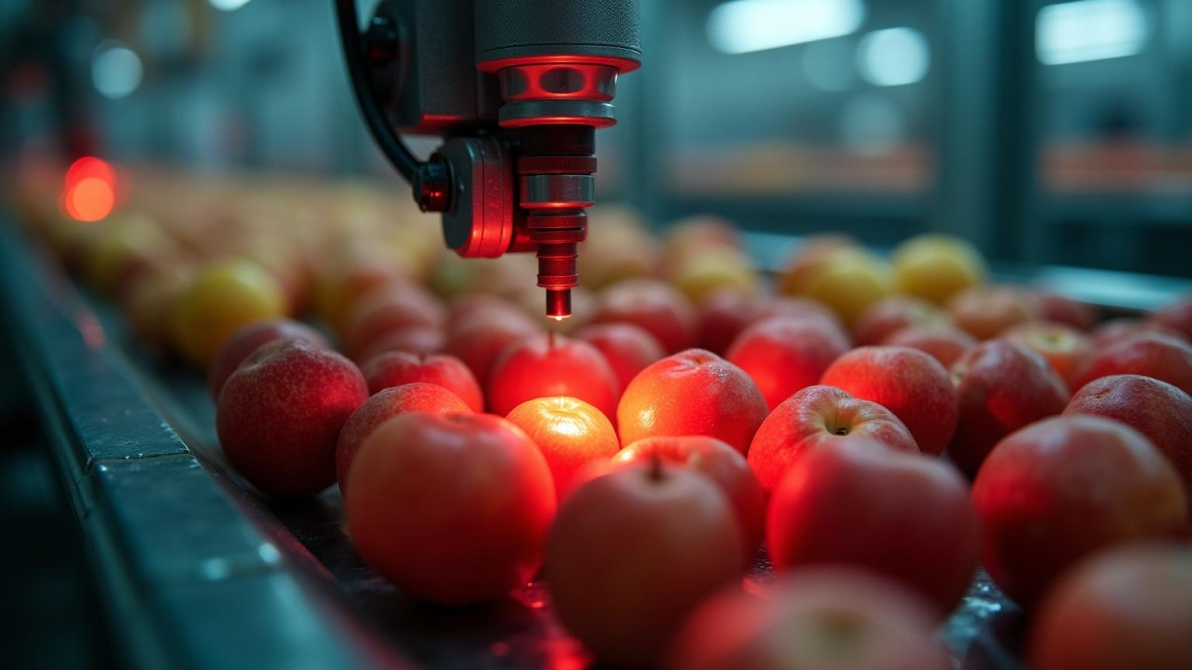
Identifying Rotten Produce
02

Slide 8
Detection Techniques
Various detection techniques are employed to identify rotten produce, including computer vision and image processing methods. These techniques leverage machine learning algorithms trained on large datasets to accurately classify fruits and vegetables based on visual features, ensuring reliable and quick assessments.

Slide 9
Data Collection Methods
Effective data collection is crucial for training models in identifying rotten produce. Techniques include gathering labeled images through controlled experiments, using field data with varying conditions, and leveraging existing datasets from agricultural research. This diverse data helps create robust models capable of handling real-world scenarios.

Slide 10
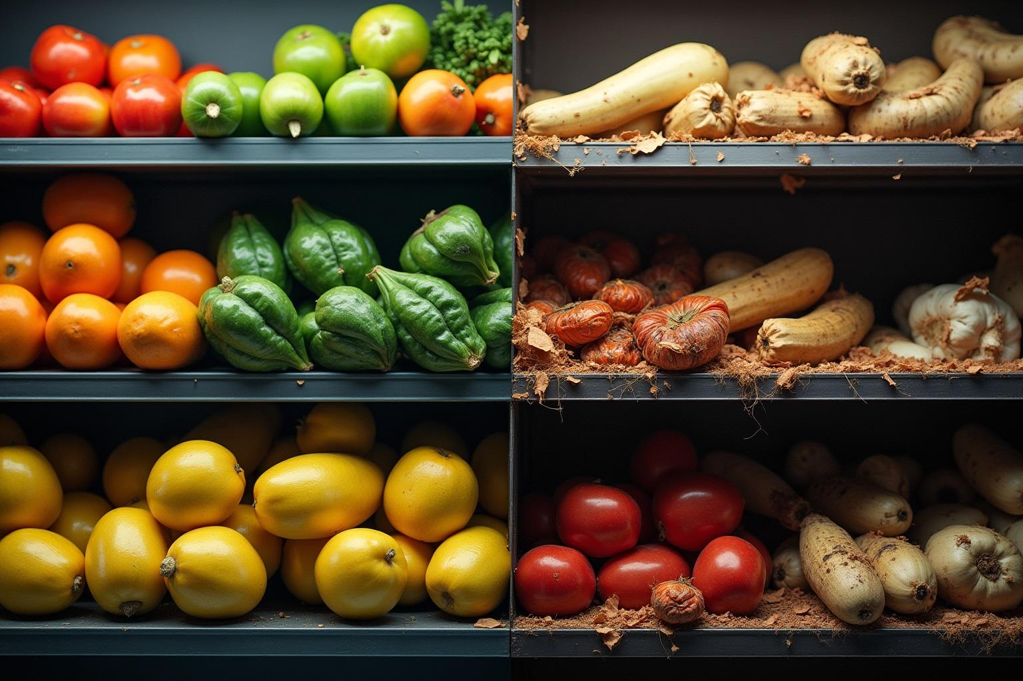
Challenges in Recognition
Identifying rotten produce presents several challenges, including variations in ripeness, environmental conditions, and the appearance of spoilage. Additionally, ensuring dataset diversity and quality is vital to train models that generalize well to different types of fruits and vegetables across various settings.

Slide 11

Conclusions
In summary, transfer learning offers a promising approach to enhance the identification of rotten fruits and vegetables by leveraging existing knowledge. Despite challenges such as data variability and detection accuracy, continued advancements in machine learning can significantly impact agricultural practices, leading to improved food safety and reduced waste.

Slide 12
Thank you!
Do you have any questions?
+00 000 000 000

